Slide 1
DBMS PROJECT

Slide 2
RAILWAY MANAGEMENT SYSTEM
PRANAV KUMAR (RA2011031010121)
RAHUL GUPTA (RA2011031010106)
P CHINMAI (RA2011031010089)

Slide 3
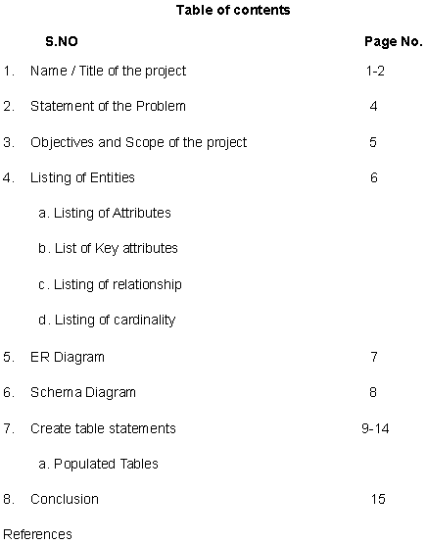

Slide 4
Problem Statement - Railway Management System
The railway network of our country is one of the most complex public establishments.
You can design a database solution for this network and make the management of the same more natural.
Your system should have the following pieces of information:-
Station names:
Tracks that connect those stations (to keep things simple, you can assume that only onetrack runs between two stations) Train IDs with names.
Schedules of the trains:
The train schedules should have information on the stations from where the train starts and by when it reaches the destination. It should also include information on which stations it passes through during its journey.

Slide 5
To keep things simple, you can assume that every train completes its journey within a day, and they run daily. However, you’ll also need to store information on the sequence of the stations a train passes through.
For example, if a train starts from Delhi and goes to Kolkata through Lucknow,
then you’ll need to add the arrival and departure times ofthe train for all these stations.
Keeping the stations in sequence will allow easy
management of trains and their data.
Till here, the project is rather easy. You can make it more challenging by adding the
passenger information of every train such as its coaches, seat numbers, types of coaches, passenger names, and so on.
This project might take some time to complete, but it’ll help you showcase your knowledge of database management solutions while solving a significant issue of a public authority.

Slide 6
Objective and Scope of the project:-
Database is an organised collection of interrelated data. The data is typically organised to model aspects of reality in a way that supports processes requiring information.
A DBMS makes it possible for end users to create read update and delete data in a
database.
The main purpose of maintaining database for railway reservation system is to reduce
the manual errors involved in the booking and cancellation of tickets and make it
convenient for the customers and providers to maintain the data about their customers
and also the seats available at them.
This project is about creating the database for railway reservation system.
The aim is to design and develop a database maintaining the records of different trains,
passengers, tracks, stations, schedule and routes.
The project also consists of station names, the tracks that connect those stations,
schedules of the train and the information of the station.

Slide 7
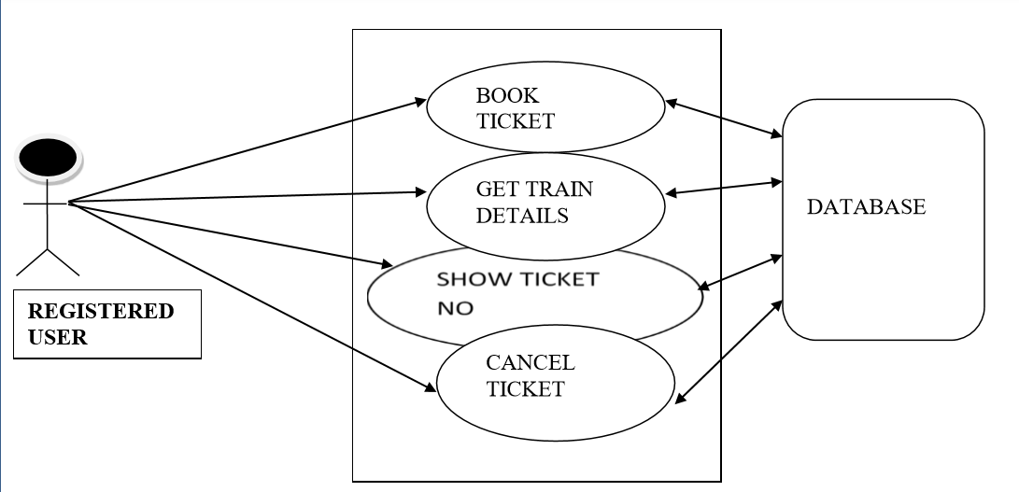

Slide 8
Entities, Attributes, Key Attributes:-
•TRAIN (T_ID, T_Name, T_Type)
•PASSENGERS (P_ID, P_Name, Gender, Seat_Number, Coaches, Age, Type
•TRACKS (Track_No, Length)
•STATION (S_ID, S_Name, Place)
•SCHEDULE (Schedule_ID, Start_Time, Source, End_Time, Destination)
•ROUTE (Route_no, Total_Stops)

Slide 9
Relationship and Cardinality Ratio:-
• PASSENGERS Travel by TRAIN (N:1)
• TRAIN Moves on TRACKS (M:N)
• TRACKS Connect STATION (1:N)
• TRAIN Follows SCHEDULE (1:1)
• SCHEDULE Has ROUTE (N:1)
• ROUTE Consists_of STATION (M:N)

Slide 10
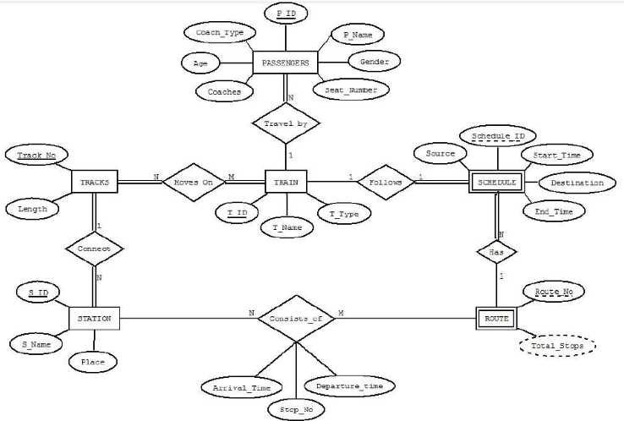

Slide 11
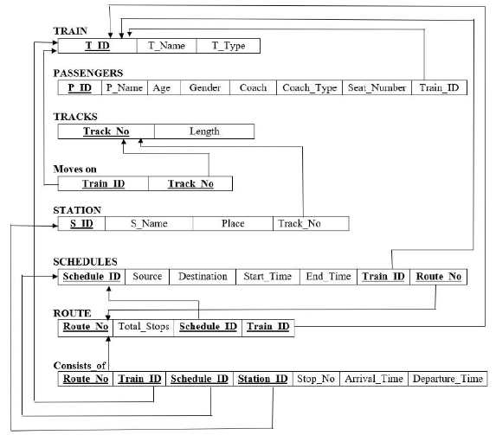

Slide 12
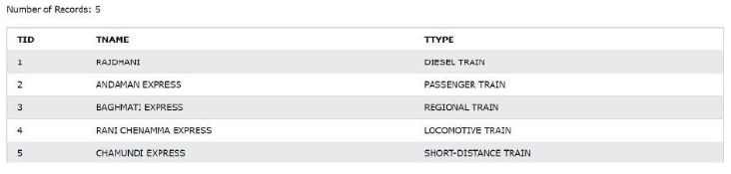
Create Table Statements and their Outputs:-
1)TRAIN
CREATE TABLE TRAIN
(
TID INT PRIMARY KEY,
TNAME VARCHAR(20),
TTYPE VARCHAR(20)
);

Slide 13
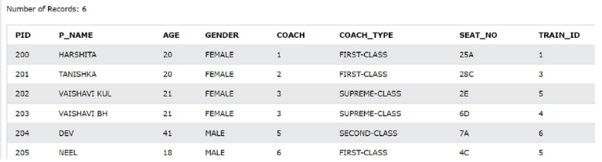
2) PASSENGERS
CREATE TABLE PASSENGERS
(
PID INT PRIMARY KEY,
P_NAME VARCHAR(20),
AGE INT,
GENDER VARCHAR(20),
COACH INT,
COACH_TYPE VARCHAR(20),
SEAT_NO VARCHAR(20),
TRAIN_ID INT,
FOREIGN KEY (TRAIN_ID) REFERENCES TRAIN(TID)
);

Slide 14
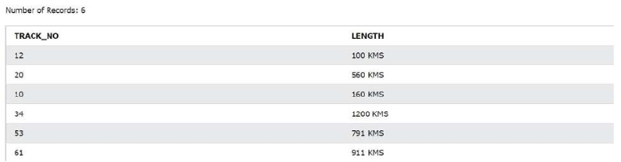
3) TRACKS
CREATE TABLE TRACKS
(
TRACK_NO INT PRIMARY KEY,
LENGTH VARCHAR(20)
);

Slide 15
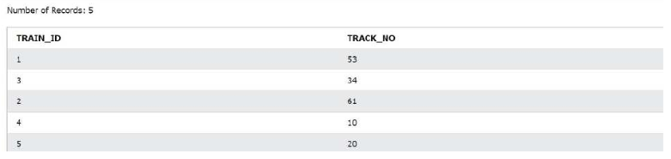
4) MOVES_ON
CREATE TABLE MOVES_ON
(
TRAIN_ID INT PRIMARY KEY,
TRACK_NO INT PRIMARY KEY,
FOREIGN KEY(TRAIN_ID) REFERENCES TRAIN(TID),
FOREIGN KEY(TRACK_NO) REFERENCES TRACKS(TRACK_NO)
);

Slide 16
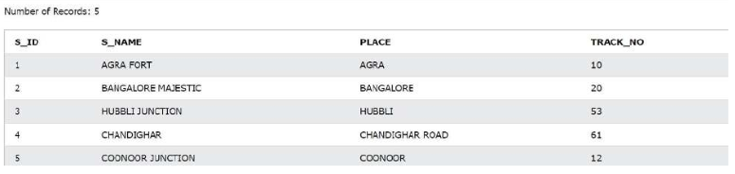
5) STATION
CREATE TABLE STATION
(
S_ID INT PRIMARY KEY,
S_NAME VARCHAR(20),
PLACE VARCHAR(20),
TRACK_NO INT,
FOREIGN KEY (TRACK_NO) REFERENCES TRACKS(TRACK_NO)
);

Slide 17
6) SCHEDULES
CREATE TABLE SCHEDULES
(
SCHEDULES_ID INT,
SOURCE VARCHAR(20),
DESTINATION VARCHAR(20),
START_TIMEVARCHAR(20),
END_TIME VARCHAR(20),
TRAIN_ID INT,
ROUTE_NO INT,
PRIMARY KEY(SCHEDULES_ID,TRAIN_ID,ROUTE_NO),
FOREIGN KEY(TRAIN_ID) REFERENCES TRAIN(TID),
FOREIGN KEY(ROUTE_NO) REFERENCES ROUTE(ROUTE_NO)
);

Slide 18
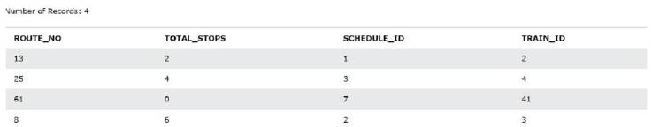
7) ROUTE
CREATE TABLE ROUTE
(
ROUTE_NO INT,
TOTAL_STOPS INT,
SCHEDULE_ID INT,
TRAIN_ID INT,
PRIMARY KEY(ROUTE_NO,SCHEDULE_ID,TRAIN_ID),
FOREIGN KEY(SCHEDULE_ID) REFERENCES SCHEDULES(SCHEDULE_ID),
FOREIGN KEY(TRAIN_ID) REFERENCES TRAIN(TID)
);

Slide 19
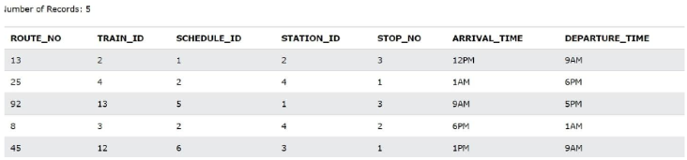
8) CONSISTS_OF
CREATE TABLE CONSISTS_OF
(
ROUTE_NO INT,
TRAIN_ID INT,
SCHEDULE_ID INT,
STATION_ID INT,
STOP_NO INT,
ARRIVAL_TIMEVARCHAR(20),
DEPARTURE_TIMEVARCHAR(20),
PRIMARY KEY(ROUTE_NO,TRAIN_ID,SCHEDULE_ID,STATION_ID),
FOREIGN KEY(ROUTE_NO) REFERENCES ROUTE(ROUTE_NO),
FOREIGN KEY(TRAIN_ID) REFERENCES TRAIN(TID),
FOREIGN KEY(SCHEDULE_ID) REFERENCES SCHEDULES(SCHEDULE_ID),
FOREIGN KEY(STATION_ID) REFERENCES STATION(S_ID)
);

Slide 20
Conclusion:-
In our project railway system we have all the information saved regarding the train,passengers, tracks, where and how the train moves, station,
schedules, routes and what does it consists of.
We had considered the most important requirements only many more features and details can be added to our project in order to
Obtain even more user-friendly applications.
These applications are already in progress and in future they can be
upgraded and may become part of Amazing Technology.

Slide 21
References:-
https://creately.com/diagram/example/hwk8yyfs1/ER%20diagram%20of%20Railway%20reservation%20System
https://www.w3schools.com/sql/sql_create_db.asp
SQL Tryit Editor v1.6
https://www.w3schools.com/sql/trysql.asp?filename=trysql_op_in

